Slide 1
A Complete City Guide Using Database

Slide 2
ABSTRACT
It is a web-based product used to store the details of particular city and helps all the users who just visits our website. This site also provides all the services like Hotel booking for tourists, Ticket booking, Transport facility providing, business related information, marketing details, city news, shopping detail. It facilitates communication between users, experts and general public through chat/polls/mail. This will definitely help the users for the purpose of saving their valuable time which can’t be got back which is also economically viable. This system provides a registration form for all who wants to get the services.

Slide 3
EXISTING SYSTEM
In the existing system of maintaining the complete City information was made through paper or documents. As everyday new places, shops, information are creating in a very fast manner. So maintaining / updating that information are not a possible one in the existing system.
A new tourist must need to verify/ keep track of new places to visit a city. And the information providers must publish ads in magazines / maps, which is a costly activity.

Slide 4
A job seeker need to verify/ keep track of employment related magazines for current openings in several organizations. And the job providers must publish ads in magazines, which is a cost effective activity.

Slide 5
DISADVANTAGES OF EXISTING SYSTEM
No User Friendly
Manual Operation
No Security Features
Existing systems are static one, which does not have feature of updating the information regularly.
Complex User interface to handle with the end users.

Slide 6
PROPOSED SYSTEM
The Proposed System provides online information about the particular city going to visit. It also provides additional services to the registered user. The development of this new system contains the following activities, which try to automate the entire process keeping in the view of database integration approach. User Friendliness is provided in the application with various controls provided by system Rich User Interface.
The system makes the overall project management much easier and flexible. The city information files can be stored in centralized database which can be maintained by the system.

Slide 7
ADVANTAGES OF PROPOSED SYSTEM
Several controls help the application to be friendly to the users.
The entire project maintenance is made simpler and more adaptable.
Internet access is possible.
During the process of project progression, there is no chance of data mishandling.
It offers great degree of security employing various protocols.

Slide 8
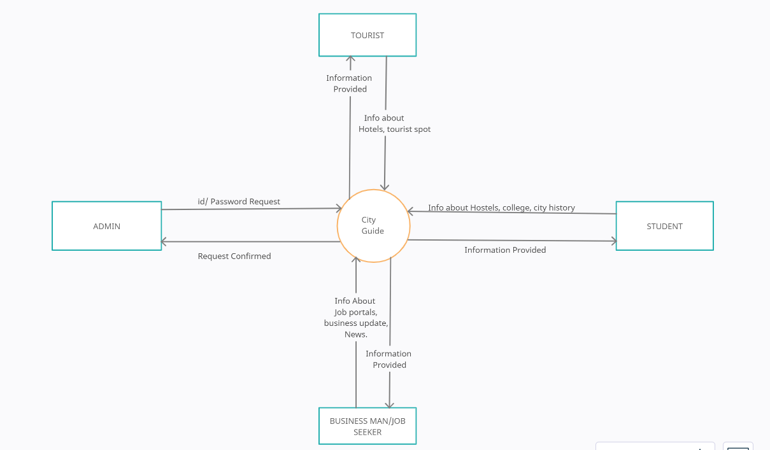
SYSTEM ARCHITECTURE

Slide 9
HARDWARE REQUIREMENTS
System : Pentium i3 Processor
Hard Disk : 500 GB.
Monitor : 15’’ LED
Input Devices : Keyboard, Mouse
Ram : 2 GB

Slide 10
SOFTWARE REQUIREMENTS
Operating system : Windows 10.
Coding Language : JAVA.
Tool : Netbeans 8.2
Database : MYSQL

